Slide 1
Lab 5
Disjoint Sets

Slide 2
Announcements
Congrats on finishing the midterm!
Homework 2 is due Wednesday, 10/9 at 11:59 pm.
Homework Party on 10/8

Slide 3
Disjoint Sets

Slide 4
Disjoint Sets
A disjoint set is a type of data structure that represents a collection of sets.
Some definitions:
Set: a collection of items where there are no duplicates (each item is unique) and order is not maintained.
Disjoint: Any item in the data structure cannot be found in more than one set, i.e. an item can only ever exist in one of the sets at a time.

Slide 5
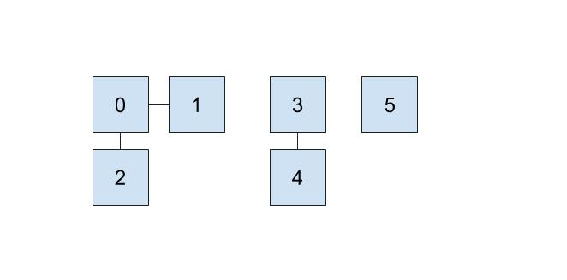
This is what a disjoint set might look like → it is a collection of sets. The sets in this representation consist of {0, 1, 2}, {3, 4}, and {5}. Notice that no specific item exists in more than one set.

Slide 6
Disjoint Sets
The main operations of disjoint sets consist of:
find: determines which set an item belongs to
union: merges two sets into one
As a byproduct, the disjoint set data structure is also referred to as Union-Find.

Slide 7
Quick Find

Slide 8
Quick Find
Given the two main operations, let’s say we prioritize making the find operation faster. To do so, we can use an array to represent our disjoint sets.

Slide 9
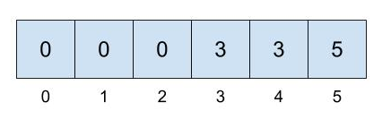
Quick Find
This is the array representation of the disjoint set that we saw earlier with the sets: {0, 1, 2}, {3, 4} and {5}. We treat the indices of the array as the items in the set and the element at each index corresponds to which set the item belongs to.

Slide 10
Quick Find
Notice that we take the smallest item to represent its entire set (i.e. 0 represents the set of {0, 1, 2} and 3 represents the set of {3, 4}, etc.). Which item we choose to represent the set is arbitrary and dependent on implementation.

Slide 11
Here is the visual representation seen earlier and its array representation. With this, we can achieve constant time for find, but end up with linear time for union!

Slide 12
Quick Union

Slide 13
Quick Union
With quick union, in our representation, we can think of our disjoint sets data structure as a collection of trees. Specifically, each set can be thought of as a tree and would have the following qualities:

Slide 14
Quick Union
With quick union, in our representation, we can think of our disjoint sets data structure as a collection of trees. Specifically, each set can be thought of as a tree and would have the following qualities:
The nodes represent items in our set
Each node only needs a reference to its parent, instead of a direct reference to the face of the set
The root of each tree will be the face of the set it represents

Slide 15
Quick Union Modifications
So, to make our union operation faster, we’ll need to make a couple of changes.
Our array structure is still the same (each index corresponds to an item)

Slide 16
Quick Union Modifications
So, to make our union operation faster, we’ll need to make a couple of changes.
Our array structure is still the same (each index corresponds to an item)
However, instead of storing the item representing the face of a set, we store the parent references of a specific item.
If an item has no parent, we will refer to this as the root of its set.
Unfortunately, depending on how we connect the disjoint sets, the worst case runtime for union will still be linear. How can we optimize this?

Slide 17
Weighted Quick Union

Slide 18
Union
While our union operation does become faster in some cases, it’s worst case is still O(N). find is also still O(N). For example, if we end up with the following disjoint sets structure, we’ll get the worst case runtime:

Slide 19
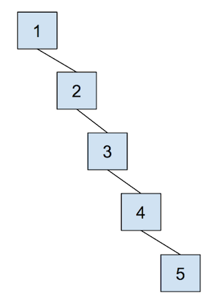
Union
While our union operation does become faster in some cases, it’s worst case is still O(N). find is also still O(N). For example, if we end up with the following disjoint sets structure, we’ll get the worst case runtime:

Slide 20
Weighted Quick Union
How can we remedy this problem?

Slide 21
Weighted Quick Union
How can we remedy this problem?
We can solve this by unioning based on size/weight. This is done to keep trees as shallow as possible and to avoid the possibility of spindly trees, like before, from forming.

Slide 22
-1
-1
-1
-1
-1
-1
0 1 2 3 4 5
0
1
2
3
4
5

Slide 23
-1
-1
-1
-1
-1
-1
union(0, 2)
union(1, 3)
0 1 2 3 4 5
0
1
2
3
4
5

Slide 24
-2
-2
0
1
-1
-1
union(0, 2)
union(1, 3)
0 1 2 3 4 5
Note: The tiebreaking here is different from the lab!
0
1
4
5
2
3

Slide 25
-2
-2
0
1
-1
-1
union(0, 4)
0 1 2 3 4 5
0
1
4
5
2
3

Slide 26
-3
-2
0
1
0
-1
union(0, 4)
0 1 2 3 4 5
0
1
5
4
2
3

Slide 27
-3
-2
0
1
0
-1
union(4, 3)
0 1 2 3 4 5
0
1
5
4
2
3

Slide 28
-5
0
0
1
0
-1
union(4, 3)
0 1 2 3 4 5
0
5
4
2
1
3

Slide 29
Summary
By convention, when we union, we connect the smaller tree (less nodes) as a subtree of the larger one.
In the case of ties, we can break it arbitrarily (some convention dictates to make the smaller-valued root the root of the combined sets, but ultimately implementation dependent)
In our array, we also track the size of a set at the index corresponding to the root as -size.

Slide 30
Observation
Given that we union by weight, why is the maximum depth of any item in our set log(N)?
N = number of stored items in the set
Notes:
WIP

Slide 31
Observation
Given that we union by weight, why is the maximum depth of any item in our set log(N)?
N = number of stored items in the set
For a particular element in the tree, its depth only increases by 1 if we union the tree to a bigger tree
This means that we have to at least double the number of elements in our set to increase the depth!
Repeated doubling indicates logarithmic runtime
Notes:
WI

Slide 32
Path Compression

Slide 33
Path Compression
How can we optimize our Union-Find data structure even more?
Consider the following Disjoint Set instance (note that this is for example’s sake, and you can’t get this structure with a weighted quick union)
0

Slide 34
Path Compression
How can we optimize our Union-Find data structure even more?
Consider the following Disjoint Set instance (note that this is for example’s sake, and you can’t get this structure with a weighted quick union)
If you repeatedly call find on the deepest leaf in this tree, i.e. find(5), you would have to traverse through each parent from the leaf to the root every time with our current implementation.
0

Slide 35
Path Compression
We can implement path compression to find an item and all the nodes on the path to the root in constant time, after the first call to find!
Path compression involves setting the parent of an item to be the root of its tree after we find the root. This also applies to every node on the path from the item to the root!

Slide 36
Path Compression
Consider the following Disjoint Set instance before Path Compression:
Tree Representation Array Representation
1
-6
1
2
3
4
0
0 1 2 3 4 5

Slide 37
Path Compression
Consider the following Disjoint Set instance before Path Compression:
Tree Representation Array Representation
1
-6
1
2
3
4
0
0 1 2 3 4 5
Let’s call find(5)-> 1
Nodes in path to root: 5, 4, 3, 2, 1

Slide 38
Path Compression
Consider the following Disjoint Set instance before Path Compression:
Tree Representation Array Representation
1
-6
1
2
3
4
0
0 1 2 3 4 5
Let’s call find(5)-> 1
Nodes in path to root: 5, 4, 3, 2, 1
Path Compression: update parent of all nodes in path to become the root !

Slide 39
Path Compression
Consider the following Disjoint Set instance after Path Compression:
Tree Representation Array Representation
1
1
-6
1
1
1
1
0
0 1 2 3 4 5
2
Let’s call find(5)-> 1
Nodes in path to root: 5, 4, 3, 2, 1
Path Compression: update parent of all nodes in path to become the root !
3
4
5
Notes:
Runtime of union is O(logN)
Amortized runtime of find becomes nearly constant

Slide 40
Lab Overview

Slide 41
An Overview
Lab 05 is due Friday, 10/4 at 11:59 pm.
As a reminder, to get the lab assignment, run git pull skeleton main in your personal repository.
Deliverables:
Complete UnionFind.java by implementing the Disjoint Sets data structure
For help, use the Lab queue:

Slide 42

Lab Attendance
https://tinyurl.com/61b-lab-att-fa24

